Slide 1

Introduction to Tech-Know School Machine Learning 1-0-1 Speaker: Raja Ram Kankipati
JAM
Tech-Know School

Slide 2
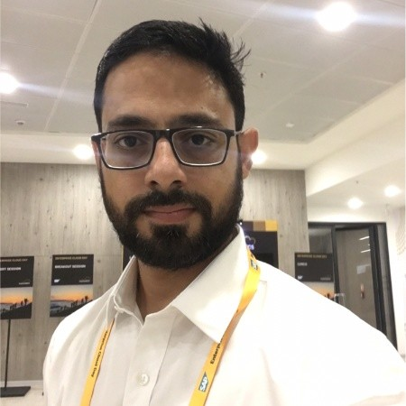

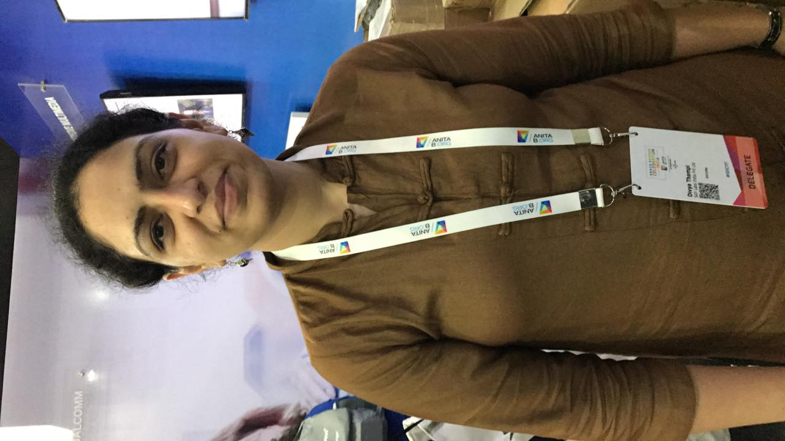
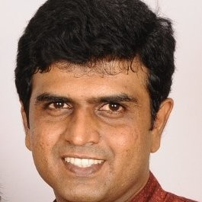
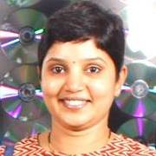
Tech-Know School Core Team
Ankush Mane
Bridge Lead, CPO and Dev Manager GS
Abhik Shome
Dev Manager: Industry Cloud and CD
V Deepa
Dev Manager: S4 Procure
C Praveen
Dev Manager: ICD FND & APPS FMS
Pinki Pachisia
Dev Manager: S4 Produce

Slide 3
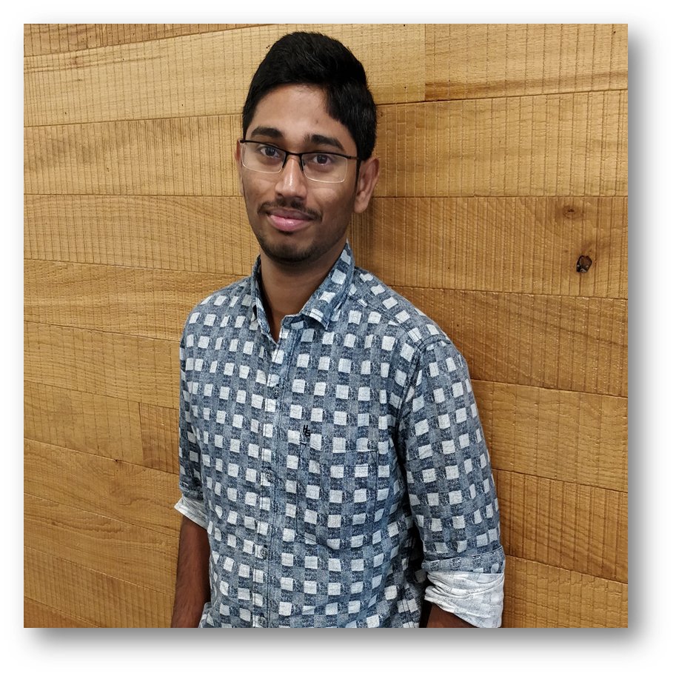
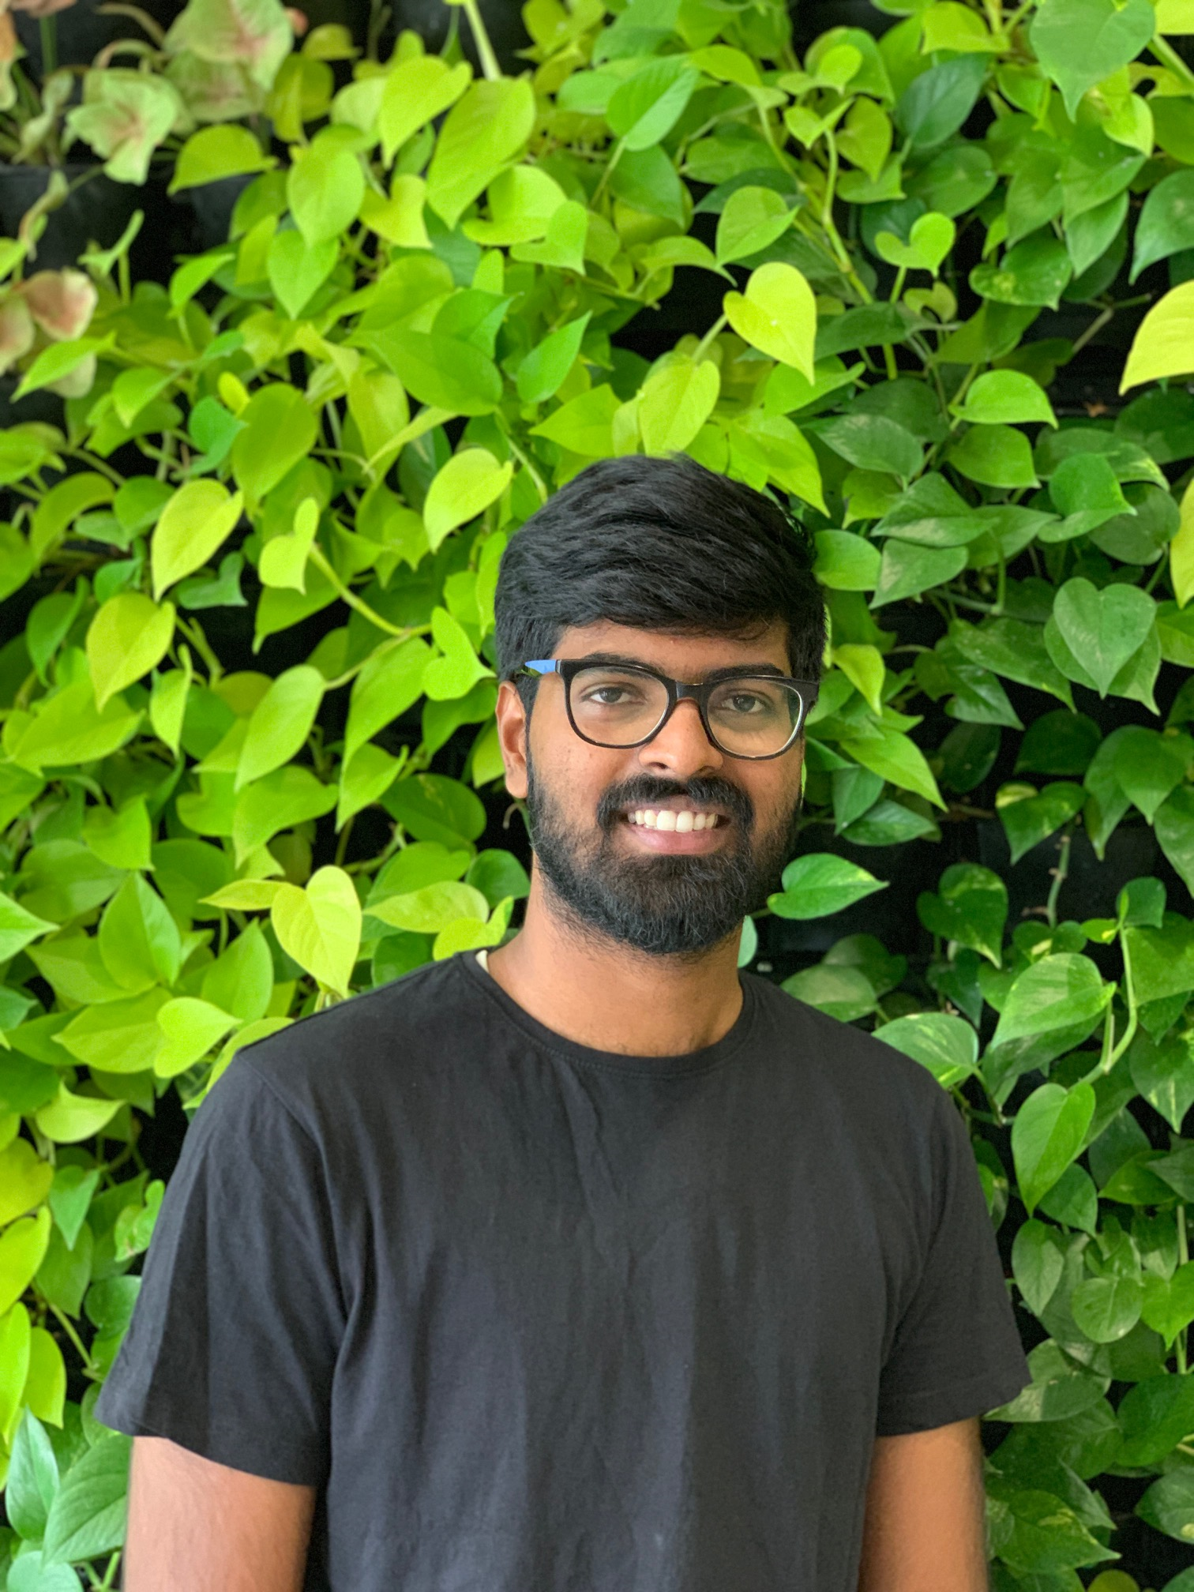


Tech-Know School Trainers
Raja Ram
ICD Oil & Gas and Mill
Sundeep
Digital Manufacturing S4 Produce
Harshit
Industry Cloud and CD
Poshak
Digital Manufacturing S4 Produce

Slide 4
Course Summary
This course is targeted for anyone who want to learn the basics of data science and machine learning and would help them to build a complete application involving end to end basic concepts.
Python and Math Foundations
HANA APL/ PAL
SAP Leonardo
Session Pre-read
Classroom learning
Interactive Quizzes
Exercise
Consulting Hour

Slide 5
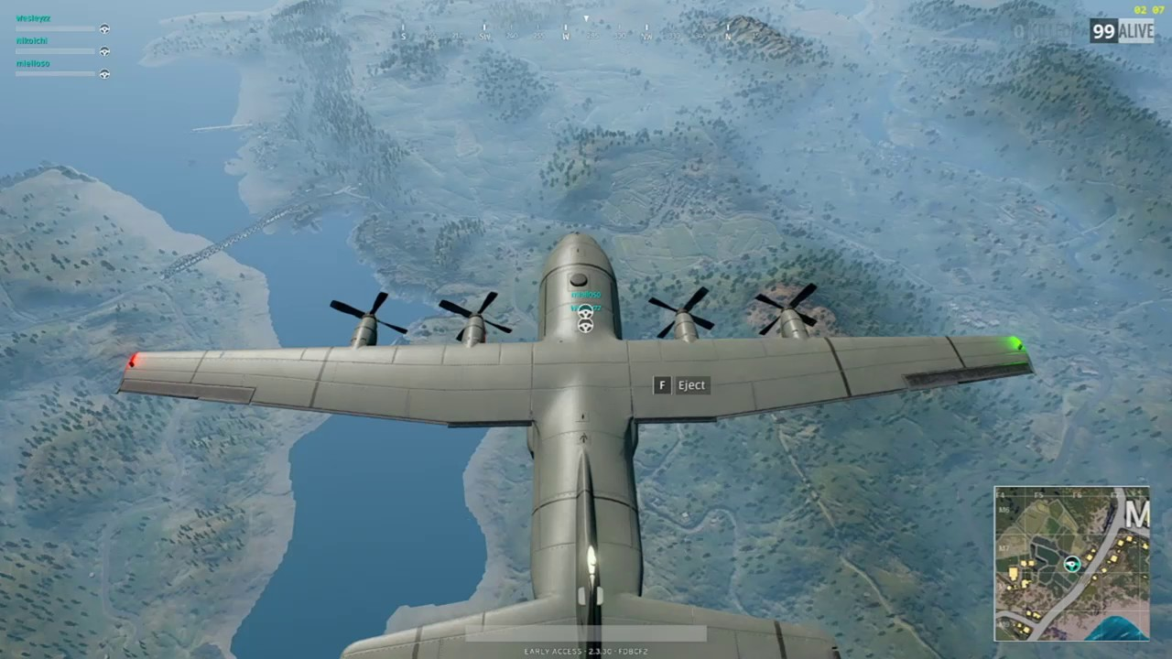
PUBG Flight Drop

Slide 6
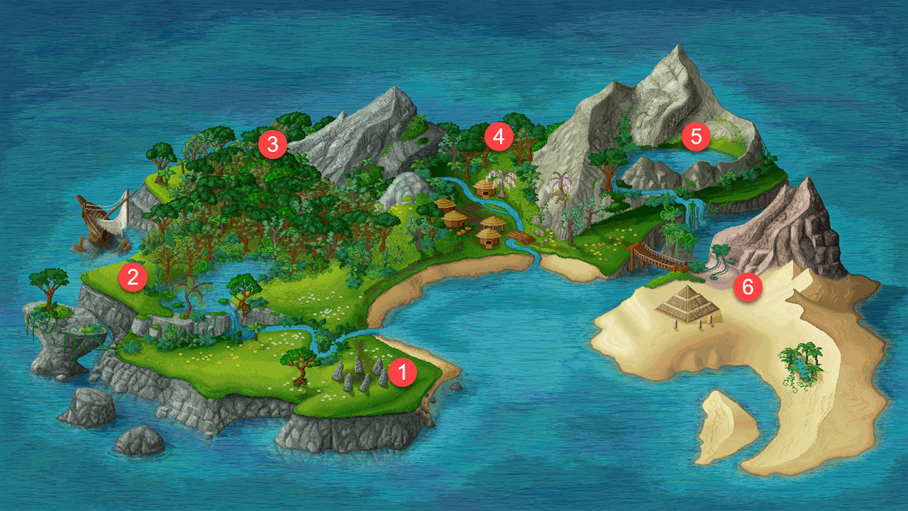
Tech-Know School Island
EDA and Visualization
ML Algorithms
PAL and APL
Python Intro and Math Foundation
Intro to ML and Data Science
SAP Leonardo

Slide 7
Tech-Know School
Acquire Future Ready Skills
Learn
Deep Dive
Practice
Hands On
Evangelize
Demo Jam Session + Learning Circle formation
Machine Learning 1-0-1
22nd April (9:30-12:30) | Intro Session– Data Science and ML Overview
 | Engagement Activities | Assignments – Hands-on and Quizzes
24th April (9:30-12:30) | Session 1 – Math foundation and Python Intro
 | Engagement Activities | Assignments – Hands-on and Quizzes
7th May (9:30-12:30) | Session 2 – Exploratory Data Analysis, Principle Component Analysis, Python deep dive
 | Engagement Activities | Assignments – Hands-on and Quizzes
15th May (9:30-12:30) | Session 3 – Algorithm Deep Dive – Regression, Classification and Clustering
 | Engagement Activities | Assignments – Hands-on and Quizzes
20th May (9:30-12:30) |  | Session 4 – Algorithm Boot-Camp
 | Engagement Activities | Assignments – Hands-on and Quizzes
27th May (9:30-12:30) |  | Session 5 – PAL/APL Boot-Camp
 | Engagement Activities | Assignments – Hands-on and Quizzes
3rd Jun (9:30-12:30) |  | Session 6 – Leonardo Services Bootcamp
 |  |  | Demo Jam session of the case study and Learning Circle formation
19th Jun (9:30-12:30)

Slide 8
Course Details and Record of Achievement
Curriculum start date : April 22, 2019
Complete Duration : 12 weeks (3-4 hours per week)
On successful completion you will be entitled to an accreditation
If you have any questions or comments, please reach out to us here.

Slide 9
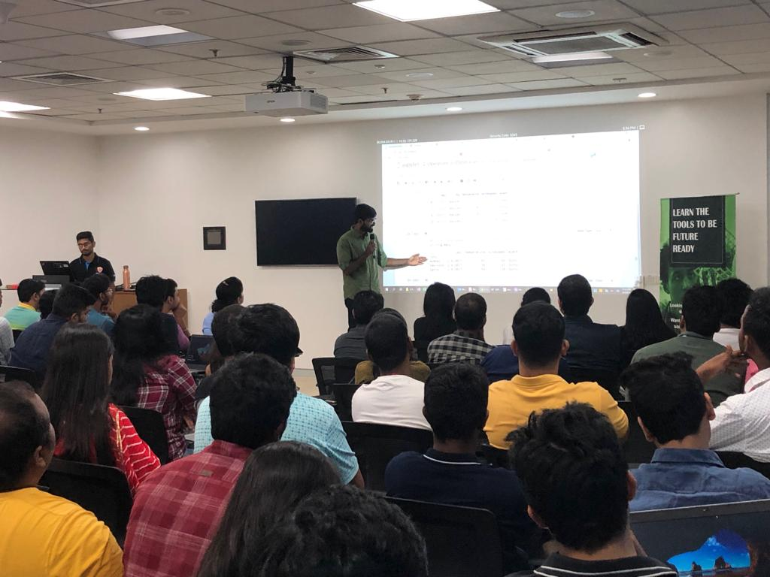
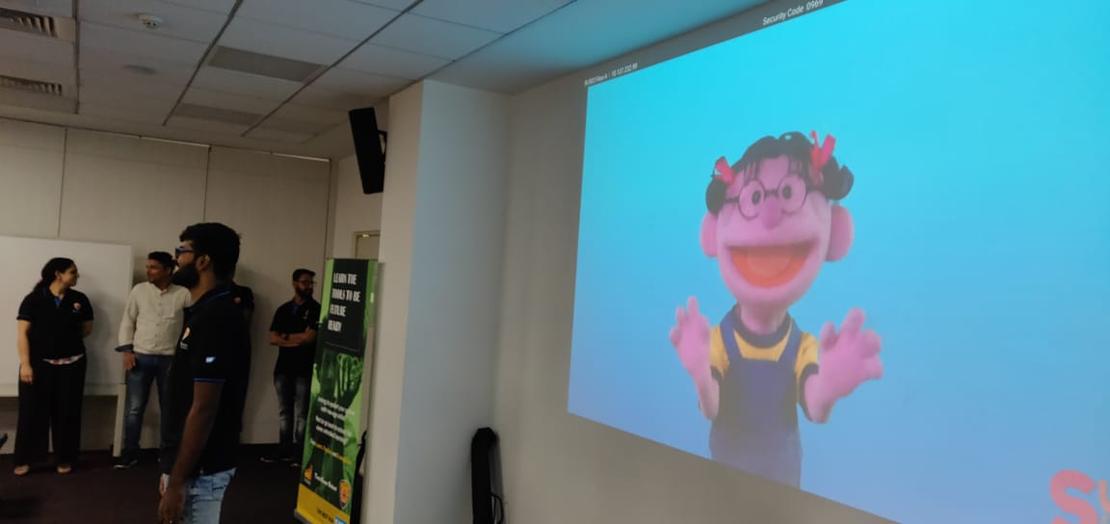
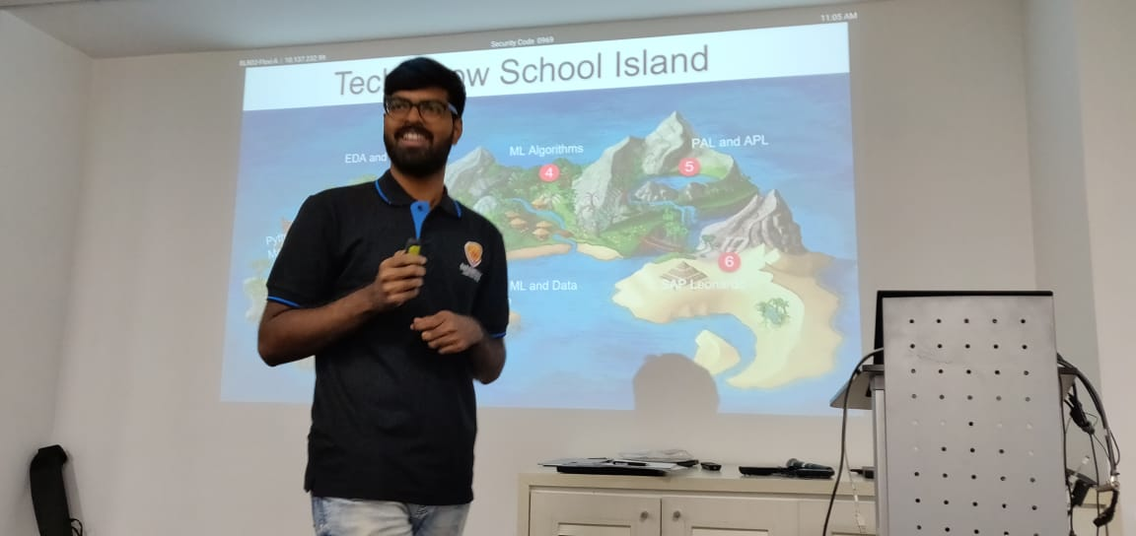

Slide 10
Thank you.
Partner logo

